Slide 1
IMDB Movie Analysis With PowerBI
Prepared by
SURIYAKRISHNAN

Slide 2
Executive Summary:
In all the sheets having lots of data but here thease are the common key variables.
Director name
Movie Title
Language
Country
Budget
Actor name
IMDB Score
Title year

Slide 3
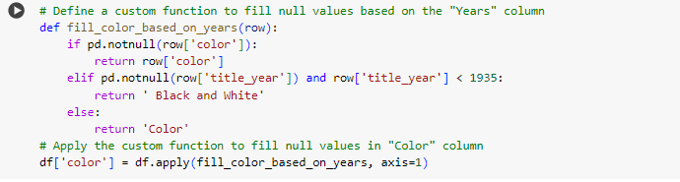
Genres: which type of movies for example(Dramatic, Comedy, ex..)
Duration
Color: Movie is Black and white or colored movies
Data Cleaning:
color column having 19 null values and here all the colored movies are released after 1935 so , the was released after 1935 that particular row will filled color
Else Black and white movie

Slide 4
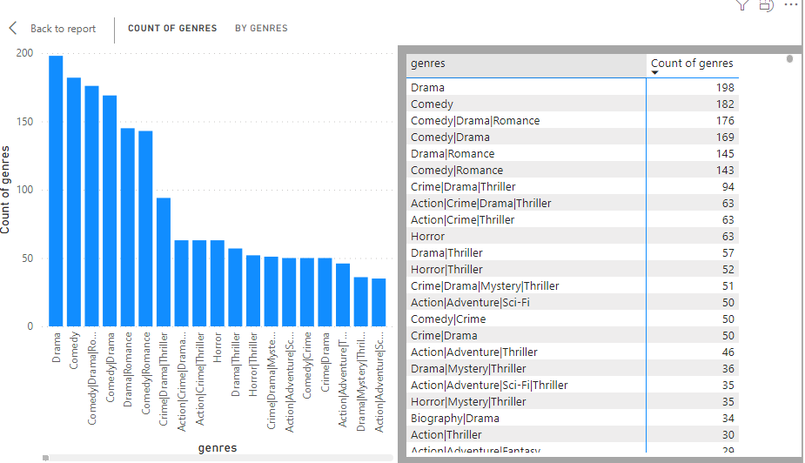
A. Movie Genre Analysis:
Listed the most common genres in the dataset.
Provided a summary of the distribution of IMDB scores for each genre.Mostly Drama , Comedy and action movies ony having more IMDB score here.
For each genre, calculate and present mean, median, mode, range, variance, and standard deviation of IMDB scores.

Slide 5
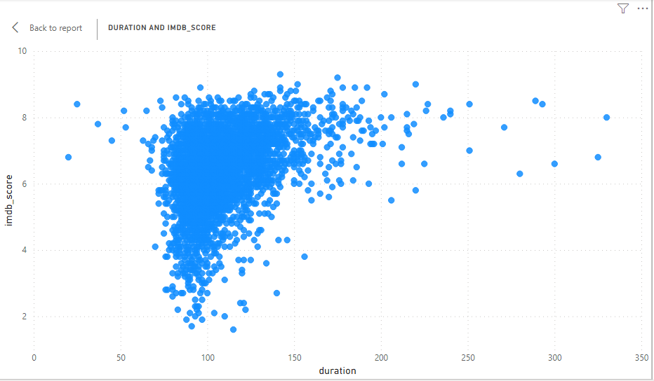
The above picture is showing how the data the IMDB scores having different genres movies.
Movie Duration Analysis:

Slide 6
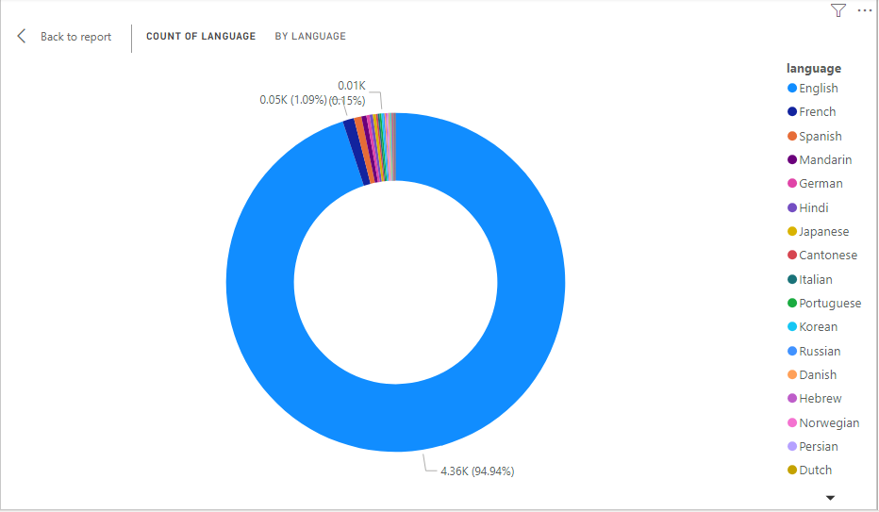
Most of the movies are average of 100 to 130 minutes
In this case the average time of 100 minutes to 130 minutes movies are getted high IMDB Ratings.

Slide 7
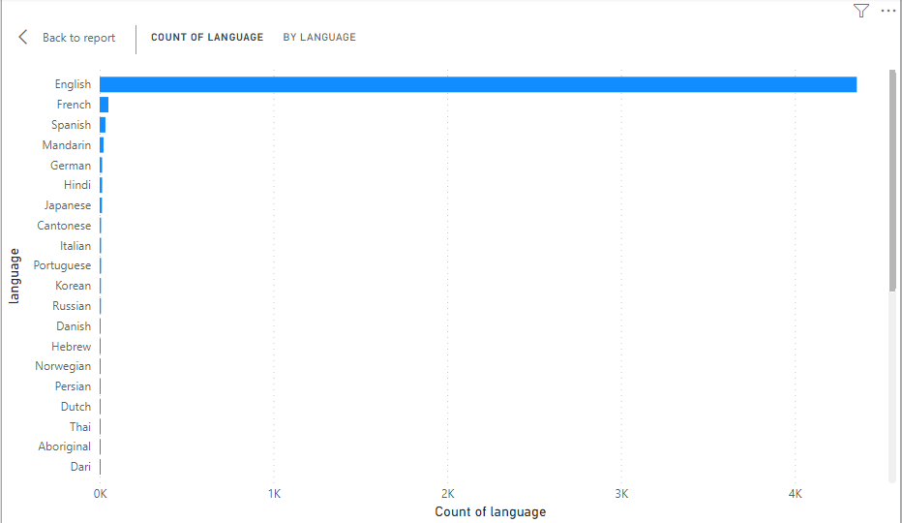
Language Analysis:
Most of the movies are coming from USA and UK and here more movies English language movies.

Slide 8
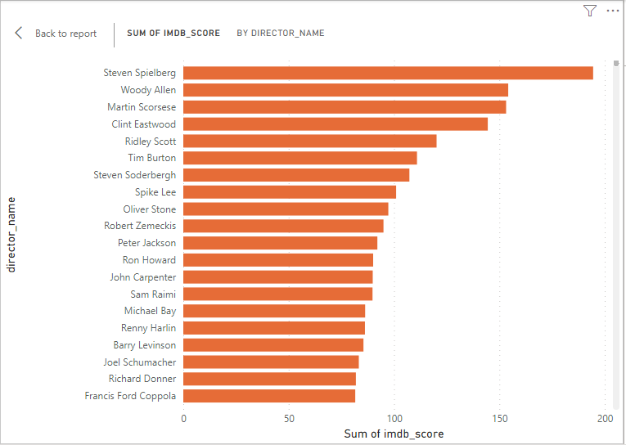
Director Analysis:

Slide 9
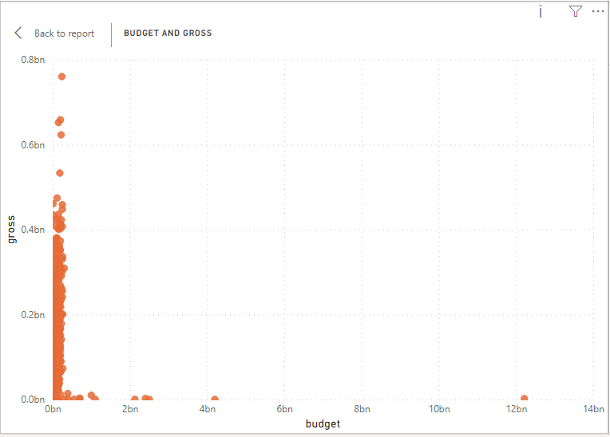
Budget Analysis:
High profited movies shows a good story related movies and thease get high IMDB rates and high profitable.
The below chart is showing how high profitable movies created as low budget

